Slide 1
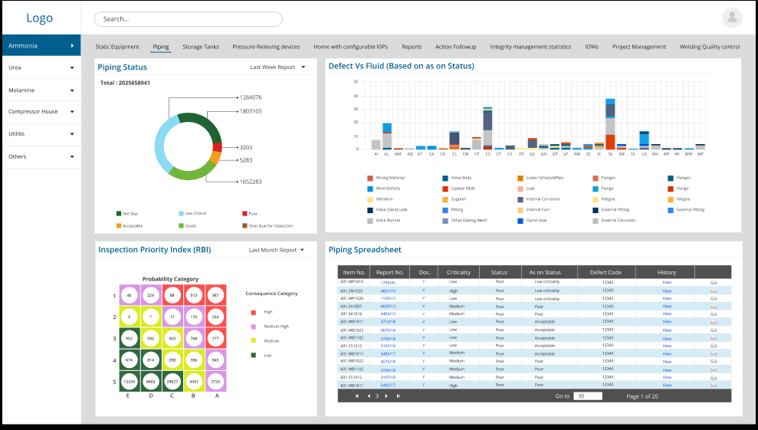
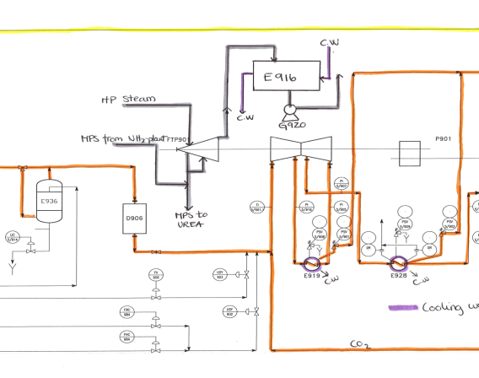
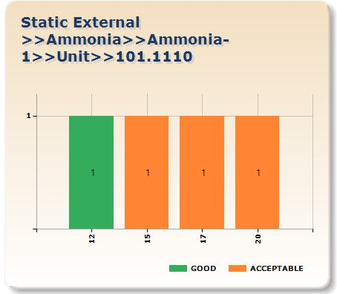
7th Tab – Other DMs
DM Code | Initial Sucep | Severity Index | Found | VH | H | M | L | Last Insp Year VH | Reduction Fac | Damage Factor | POF | DM name
Reports Menu
Piping
POF
COF
TML
ML no | Nom Thk | Dia | Min req t | Last Mea | Long T CR | Short Te | Half Li | Next I
01 | 5.6 | 6 | 3 | 4.5 | 0.15 | 0.1 | 5 | 2025
02 | 6 | 8 | 4 | 5 | 0.1 | 0.1 | 5 | 2025
03 | 7.2 | 10 | 5 | 6.5 | 0.25 | 0.2 | 10 | 2030
When a line number Other DMs tab is selected the charts will change to as shown above.
Top : will show a form with all relevant data required for SCC POF calculations of all relevant SCC DMs.
Right Bottom: shows the bar charts showing previous inspection confidence levels for this DM – for the DM row that is selected in above table
Left Bottom: Will show the drawings (may be more than one) indicating the CML locations on the drawing

Slide 2
Left Table
SCC Damage Mechanism
DM Code | Initial Sucep | Severity Index | Found | VH | H | M | L | Last Insp Year VH | Reduction Factor | Damage Factor | POF | DM name
In this table all relevant data is shown, all this data is populated from different tables like Piping Cluster table, Inspection confidence table.
Adding new DMS and Editing is possible by Integrity engineer.

Slide 3
Right top- TML locations
Drawing
In this window user should be able to attach marked document in pdf format.

Slide 4
Left Bottom- CML Trends
Confidence Level- Trend
In this window a graph showing the trend of Inspection confidence level from Inspection Confidence history table for this line for the selected row from the above table.

